Slide 1
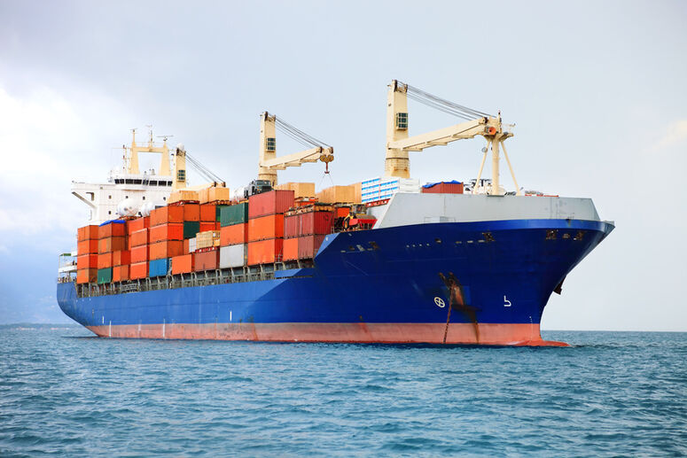
WELCOME TO USASA ENTERPRISES PVT LTD.
www.usasaenterprises.com

Slide 2
Who are we?
USASA Enterprises Pvt Ltd was established in year 2023 to financial year. the Company has been thriving as a one of the most prominent names in Express Distribution Services across India. USASA is a trusted name for resolving the first and last mile connectivity concerns with its door-to-door services through all means of multi-modal transportation and vast warehousing network.
We are not just into distribution services, but also into full-fledged logistics services as well. We have our offices in ICD Tughlkakabad,CFS Patparganj, IGI Airport, ICD Dadri, ICD Ghari Harsaru, ACTL Faridabad, HTPL Palwal, ICD Sonipat/Panipat.
Nhava Sheva, Mundra sea port and many other cities across India.
We offer single window solutions to our Customers. We have dedicated inland transportation services from Delhi-NCR to all vessel dispatch ports across India, and also bonded trucking services from Delhi to Mumbai ports.
www.usasaenterprises.com

Slide 3
What we do…
Transportation
Primary Transportation.
Secondary Transportation.
Express Transportation.
Reverse Logistics.
ODC Project.
Refer Transportation.
Hydraulic Vehicle.
Warehousing
Warehousing Solutions.
Independent Warehouse Operations.
Multi-user Warehouse Operations.
In-plant/ factory warehouse operations on Mundra Port.
www.usasaenterprises.com

Slide 4
Challenges faced by the customers
Lack of Visibility and Transparency
Multiple Supplier-Partner Relationships
Customer Service Concerns and Response Delays
Planning and Risk Aversion Management
Inventory and Cost Control
Lack of Online options and digital integration
www.usasaenterprises.com

Slide 5
Our Service's
TIME BOUND DELIVERY
SPECIALIZED CONTAINER MOVEMENT
GPS TRACKING
TRANSPARENCY
SATISFACTION
LCL CLOSED BODY TRUCKS
www.usasaenterprises.com

Slide 6
Project Handling
USASA professional transportation team, Assets and strong network is capable to meet customers various requirements. Our advance fleet and experienced personal ensures safe and secure movement of goods. We are specialized in cross border, oversize dimension cargos, oil and gas, temperature controlled, Project Cargo Transportation etc. with our modern fleet and rich experience of expertise, enable our truck services to deliver secure, cost effective and comprehensive services on time. We undertake back loading of empty containers and local transportation for exporters and importers. We offer comprehensive door to door cargo handling services including stuffing, de-stuffing, storage and transportation.
www.usasaenterprises.com

Slide 7
Why us…
Commitment of Delivery/ Pickup to and from any corner of India.
Direct Control of our own/ fixed transport fleet of specialized vehicles.
Best of breed associations in providing end-to-end
service.
Expert Knowledge of Export Movement & Projected Demonstration.
Wide network of Warehousing facilities for secure storage and rapid movement of all cargo.
Dedicated specialized, owned facilities in entire network.
www.usasaenterprises.com

Slide 8
Business Partner…
www.usasaenterprises.com

Slide 9
www.usasaenterprises.com

Slide 10
www.usasaenterprises.com

Slide 11
Company Details….
USASA ENTERPRISES Pvt Ltd.
B-72/73, ROHIT HOUSE, T/F, Vishwakarma Colony
PUL PAHLADPUR, SOUTH DELHI, Delhi -110044, INDIA
Name:- Sanjay Upadhyay
Contact No:- 9582421000
Email Id:- skupadhyay@usasaenterprises.com
usasaentp@gmail.com
Name:- Sanjeev Kumar Yadav
Contact No:- 9711117753,9716163456
Email Id:- sanjeev@usasaenterprises.com
usasaentp@gmail.com
Name:- Ankit Mishra
Contact No:- 8527008934
Email Id:- info@usasaenterprises.com
usasaentp@gmail.com
Name:- Mohd. Anjar
Contact No:- 9711117853
Email Id:- info@usasaenterprises.com
usasaentp@gmail.com

